Slide 1



Work Hasn't Changed In Decades
But the world has.
Notes:
“Welcome.” (hold three beats — let the line speak for itself)
For decades we’ve upgraded almost everything — phones, cars, even coffee machines — yet most organisations still run work on the same operating system they installed in the ’90s.
By choosing to be in this room today, you’ve stepped into a once-in-a-generation moment to rewrite that script. Congratulations for raising your hand to lead the change.

Slide 2


Why Are We Still Operating Like It’s 1995?
The world is moving at AI speed, but our work models are stuck.
Traditional jobs, hierarchies, and operating models no longer serve the speed and complexity of today’s world.
We need to boldly re-engineer how work gets done
Notes:
“1995 gave us floppy disks and shoulder pads. It also gave us job descriptions, career ladders and approval chains we still copy-paste today. Meanwhile AI engineers ship code at the speed of thought. Traditional roles and hierarchies just can’t keep up—so today is about re-engineering how work gets done.”

Slide 3



Businesses Aren’t Ready
and People Are Being
Left Behind
Invisible
work
Misguided AI decisions
Workforce resistance
Siloed
data
Disconnected strategies
We don’t know who’s doing what.
Not aligned to strategy.
Fear of AI.
Broken systems.
People and AI are misaligned.
This isn’t just a technology problem, it’s a crisis of alignment.
Notes:
We are standing in a full-blown work crisis.
A crisis not of talent, not of technology, but of out-dated frameworks that waste the very potential they were built to unleash. Across every industry, the same problems appear:
• Invisible work
• Misguided AI bets
• Workforce resistance • Siloed data
disconnected plans
These are the systematic leaks of opportunity. And this crisis of alignment, is it’s costing us dearly

Slide 4
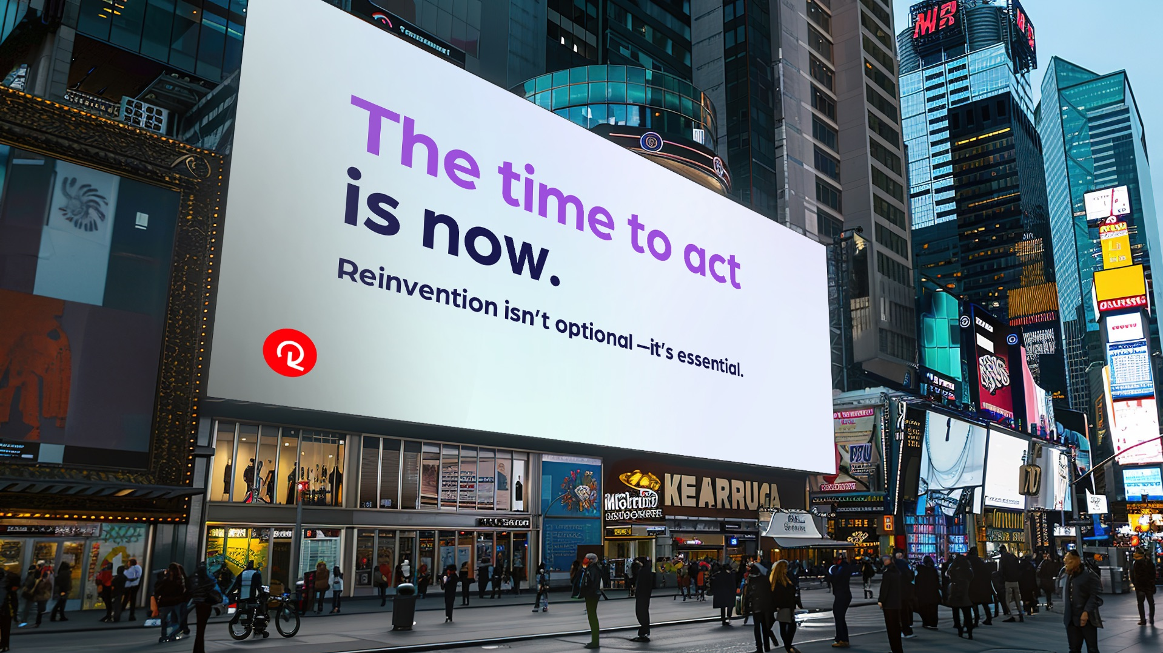
Notes:
This moment needs you. The only thing between you and the future is choosing to start—so hit go, right now

Slide 5
Your Toolkit for the
New World of Work
People have Skills
Jobs have Tasks
Tasks need Skills
AI Automates Tasks, Not Skills
Notes:
A new era demands a new toolkit People have skills.
• Jobs have tasks.
• Tasks need skills. - AI does not automate the skills, it automates the tasks

Slide 6

The World Demands Bold & Responsible Reinvention
Make work visible.
Align AI to business priorities.
Re-engineer jobs to embrace AI.
Empower people to see AI as an enabler.
Reskill and redeploy.
Ensure no one is left behind.
Bold Reinvention
Responsible Leadership
Join
Notes:
Normal talk track

Slide 7

You are not just leading teams, you are leading a workforce revolution.
Once-in-a- Generation Leaders Shape the Future
How you show up today and the decisions you make will define whether your organization thrives or stalls.
The world needs leaders who are bold enough to act and responsible enough to care.
Notes:
This is a once-in-a-generation change. You are the once-in-a-generation leaders. There will never be a moment like this ever again.

Slide 8



This Week’s Challenge
This week, I want you to do ONE thing:
Start a conversation with your team about what the AI-powered workforce means for your roles. Be honest. Be curious. Start shaping it, together.
Notes:
“1995 gave us floppy disks and shoulder pads. It also gave us job descriptions, career ladders and approval chains we still copy-paste today. Meanwhile AI engineers ship code at the speed of thought. Traditional roles and hierarchies just can’t keep up—so today is about re-engineering how work gets done.”

