Slide 1



The Death of the Job Architecture
Notes:
“This week, we’re unpacking a big one—why the traditional job architecture is no longer fit for purpose.
For decades, orgs have been built around fixed roles, predefined job families, and structured hierarchies. It gave us consistency, but it also created rigidity. The problem now is the world of work has changed—and fast.
Even before AI came on the scene, we were already questioning whether job architecture could keep up. It was slow to evolve, disconnected from how work actually got done, and made it hard to move people where they were needed most.
So in this session, we’re going to break down what’s changing, what that means for how we structure our workforce, and why evolving past the job is critical to building an AI-powered workforce.”

Slide 2
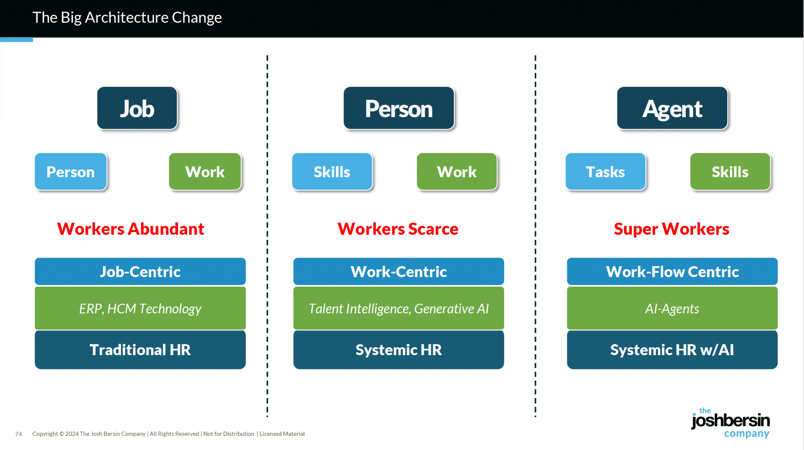
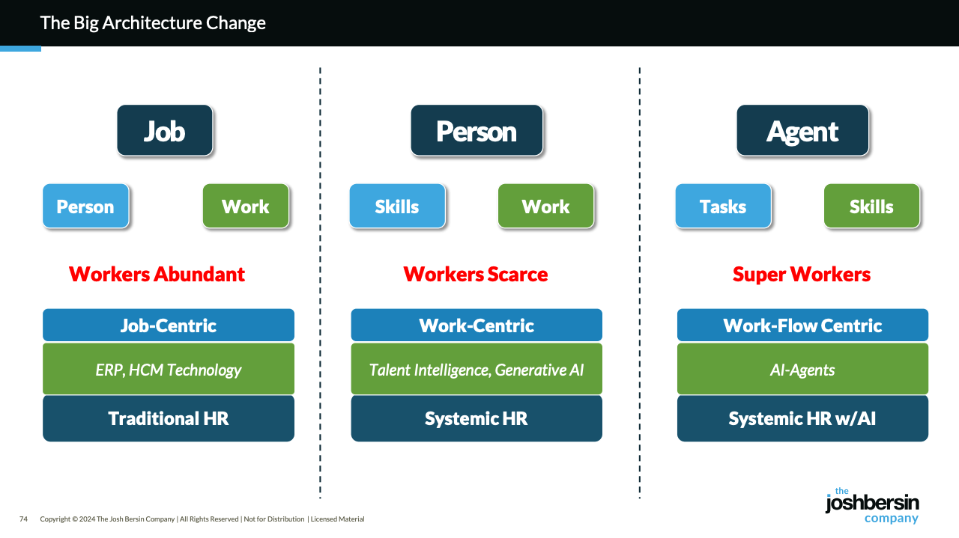
The slide that Josh Bersin Uses on job arch
Notes:
What you’re looking at here is the shift we’re seeing in how companies need to structure their workforce strategy. On the left, you’ve got the traditional model where everything was built around the job. That made sense when workers were abundant and work was relatively stable. But it locked people into static roles and left no room for agility.
In the middle, we see the move to a person and skills-centric model. This is where most companies are stuck right now. They’ve realized jobs don’t tell the whole story, but they’re still retrofitting outdated systems and guessing at skills.
On the right is where the world is going. We’re entering an era of super workers—humans working alongside AI agents. To operate in this world, you need a live, dynamic view of the work being done, the skills and tasks required, and how humans and AI can be orchestrated together. That’s the architecture we’ve built at Reejig with our Work Ontology.”
🔥 SLIDE 1
Title: Why Job Architecture is Dead
Content:
Built for a world where work changed slowly — that world is gone
AI is reshaping work: some tasks disappear, others emerge overnight
We’re still hiring, reskilling, and assessing against outdated job descriptions
We’ve missed the core unit of work: tasks
Without task-level visibility, we hire, train, and measure the wrong things
HR can’t stay in sync with the business if it doesn’t understand the real work

Slide 3

Why this can’t wait?
Even before AI, job architectures were already behind.
Now, we need to completely rethink how we define work — and fast.
This isn’t next year’s problem. AI is already reshaping the workforce.
Every day we delay:
👥
HR and the business drift further apart
🪦 We build people strategies for a world that no longer exists
📉 We rely on outdated spreadsheets with no visibility into real work
🧭 We hire, train, and plan for jobs that have already changed — or don’t exist anymore
If we don’t evolve now, we’ll fall behind — not from lack of effort, but from working off a structure that can’t keep up.
Notes:
This is not a future problem. AI is already reshaping the workforce. The way we define work today is fundamentally broken, and if we don’t evolve now, we’re going to fall behind—not because people aren’t trying hard enough, but because they’re working from the wrong structure.
Every day we delay, we see the cracks widen: HR and the business lose alignment, workforce strategies are built for a world that no longer exists, and decisions are based on static spreadsheets that have no visibility into how work is actually done.
We end up hiring and training for jobs that are outdated or irrelevant. This is exactly why we built the Work Ontology—to replace outdated architecture with a live, dynamic understanding of how work, skills, people, and now AI, truly interact inside a business.”

Slide 4
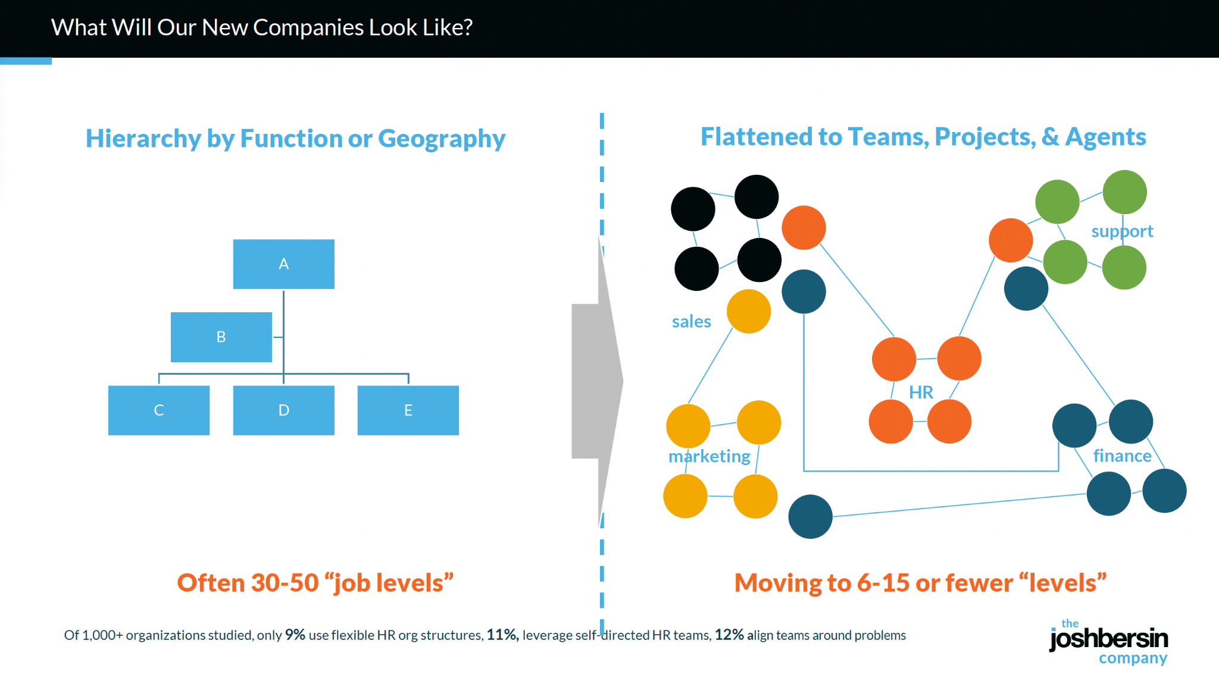
Notes:
Most organizations today are still structured around traditional hierarchies—rigid org charts based on function or geography, with 30 to 50 job levels. That model is completely misaligned with the way work actually flows.
What we’re seeing now is a shift toward flatter, more dynamic structures. Work is happening in teams, projects, pods, and increasingly, alongside AI agents. Instead of static roles and chains of command, people move fluidly between initiatives. But this shift can’t happen if you’re still trying to manage the business based on outdated job architecture.
This is where our Work Ontology comes in. It gives companies a dynamic view of the work being done, who can do it—human or AI—and what skills are needed, so they can actually support these new ways of working. We’re moving from headcount management to work orchestration.”

Slide 5
The New Work Architecture
The Critical Infrastructure for an AI-Powered Workforce
Component (What it Needs)
Why It Matters
👥
Role, Role Group, Role Hierarchy & Standardization
Creates a consistent foundation across the org; supports clarity, equity, and global alignment
💼
Tasks & Subtasks
Brings visibility to actual work; enables AI vs human mapping, automation, and operational design
📉
Outcomes & Responsibilities
Clarifies what success looks like; connects roles to business impact and performance expectations
🛠️
Skills Needed for Tasks
Drives accurate hiring, learning, and mobility; links skills directly to value-creating work
💸
Compensation & Reward Bands
Aligns pay to real contribution; ensures fairness across evolving, AI-augmented roles
🔀
Career Paths & Pivot Pathways
Powers mobility across roles and functions; helps people transition as work evolves
Notes:
“If we want to build an AI-powered workforce, we need better infrastructure. Not systems or software—but the actual architecture that defines how work is structured, understood, and deployed.
This is what that looks like.
You still need the basics—roles, role groups, and some level of standardisation. That gives you consistency across the business and makes sure you're operating with clarity and equity.
But beyond that, you need a much more detailed, dynamic understanding of work. You need to know the tasks and subtasks being done. You need to define outcomes, not just responsibilities—because that’s how you measure impact.
You also need to connect tasks to the skills required to do them, especially when deciding what can be done by people and what can be handled by AI. Without that link, you can’t drive accurate hiring, learning, or automation.
Compensation needs to evolve too. As roles become more fluid and augmented by AI, pay needs to reflect real contribution, not just job level.
And finally, mobility. Career paths can’t be linear anymore. People need to see how to pivot, grow, and shift across roles as the work evolves.
This is the new work architecture. Without it, we’re trying to run AI-powered workforces on outdated foundations.”

Slide 6
Work Architecture Powers
Work Architecture
Work Ontology
🤖
AI Strategy & Implementation
🎓
Reskilling & Learning
📥
Hiring & Internal Mobility
📊
Resource Allocation
🛠️
Organizational Agility
Notes:
This is the critical infrastructure for an AI-powered workforce.
Work Architecture, underpinned by the Work Ontology, gives you one common language of work across the entire organisation. It’s not just a HR tool—it’s how HR and the business stay aligned.
When you have a shared, structured view of work—down to tasks, skills, outcomes—you’re no longer having different conversations in silos. AI strategy, reskilling, hiring, mobility, resource allocation—it’s all connected. You’re not trying to retrofit one team’s data into another’s decision-making.
This foundation means everyone—from the CHRO to the COO to the CIO—is speaking the same language about how work gets done, who can do it, and where to invest next.”

